Slide 1
Computer Hardware Activity
Amrit PREET Kaur

Slide 2
Assignment: Design A Gaming PC
Create a gaming computer design under $900
Choose and research each compatible component of the pc on-line, in stores or from flyers
Explain why the part chosen is the best option and show the price of each part and total in a table.
Submit power point or word document with screenshots or pictures of each part with its specifications (e.g. part name, make, price, store name etc.) or video displaying each parts specifications clearly.
The following slides present an example of the parts with specification.

Slide 3
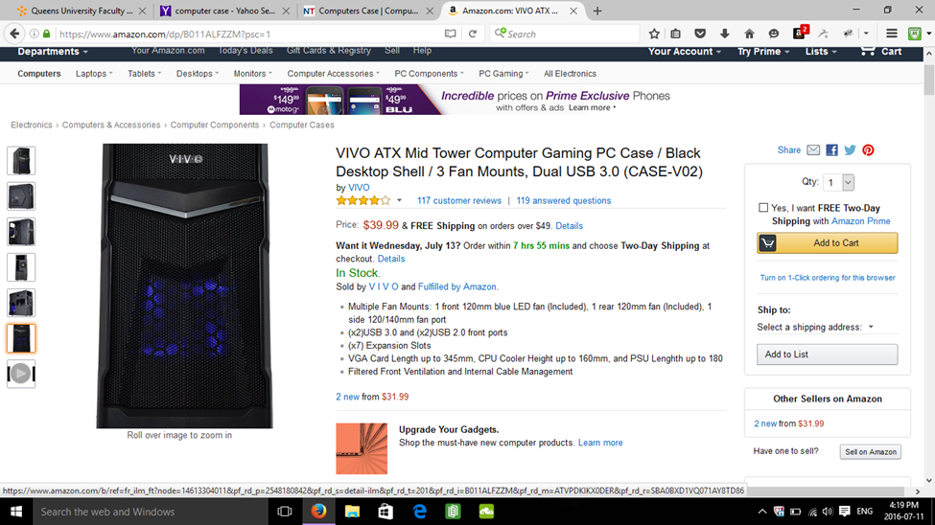
Example of gaming computer design under $700
Mid-Tower Computer Case

Slide 4
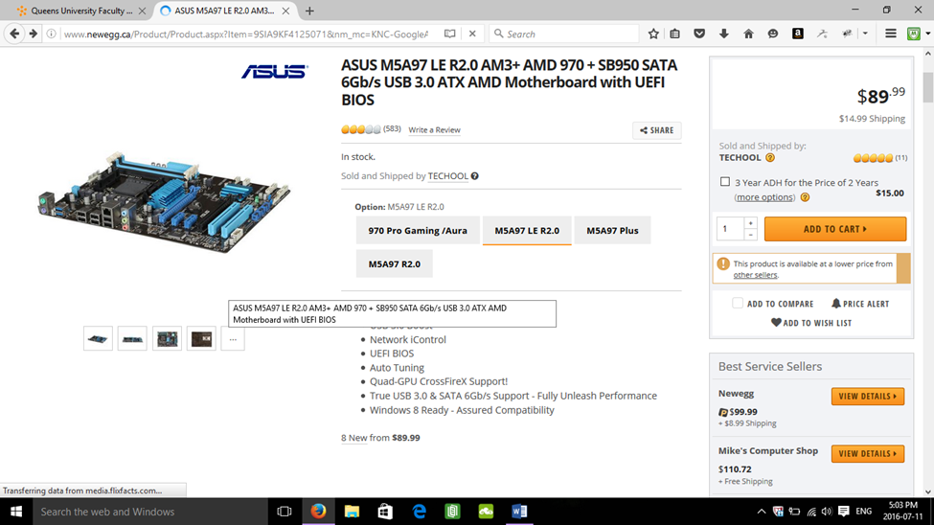
Example Continued
Motherboard

Slide 5
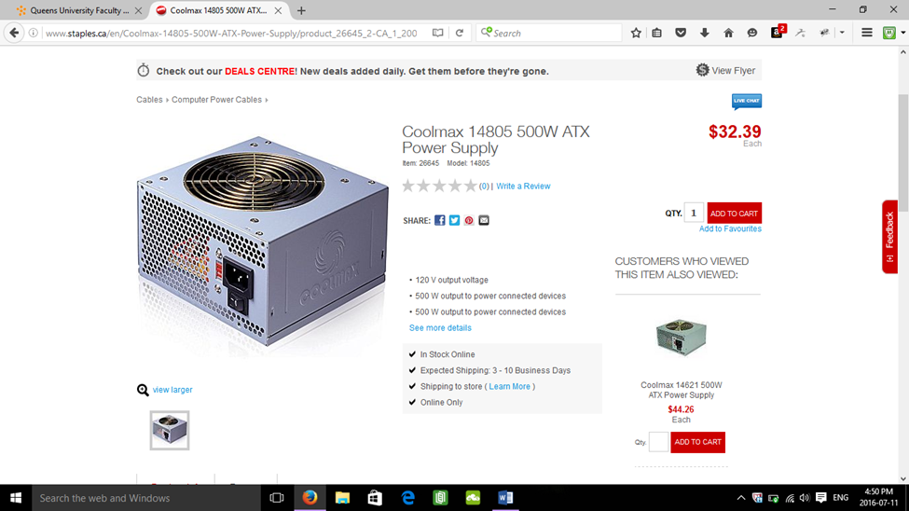
Example Continued
Power Supply

Slide 6
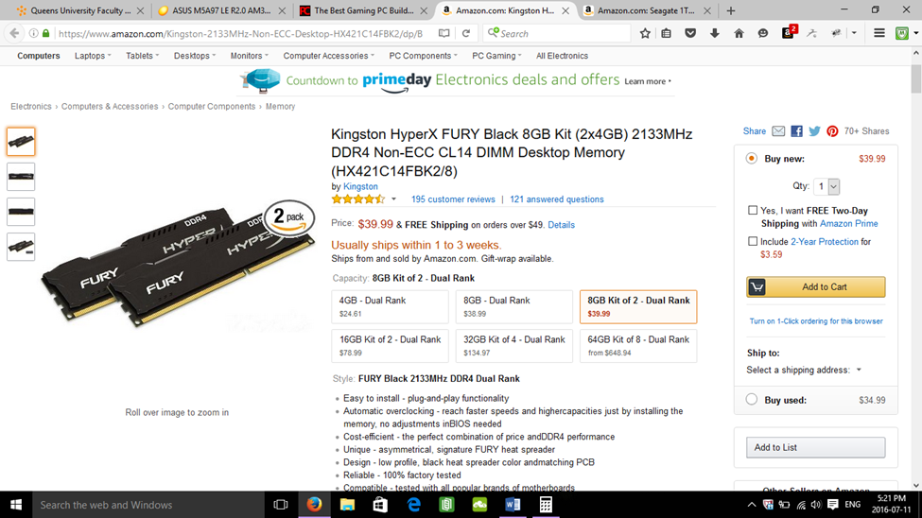
Example Continued
Random Access Memory (RAM)

Slide 7
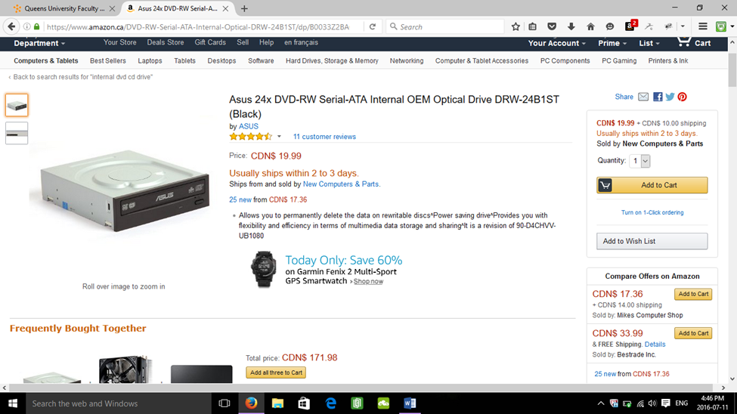
Example continued
CD Drive

Slide 8
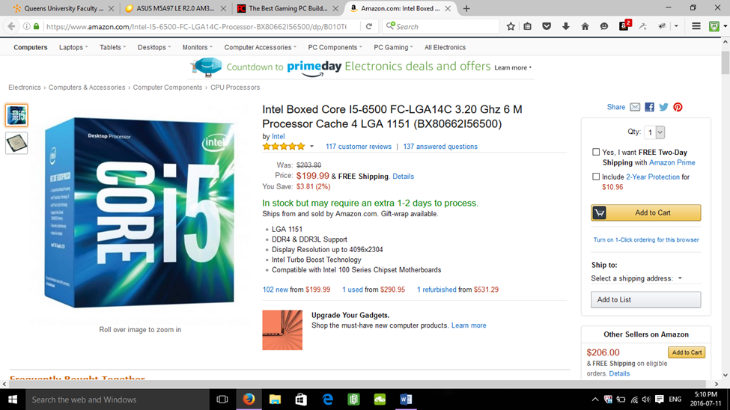
Example continued
Central Processing Unit (CPU)

Slide 9
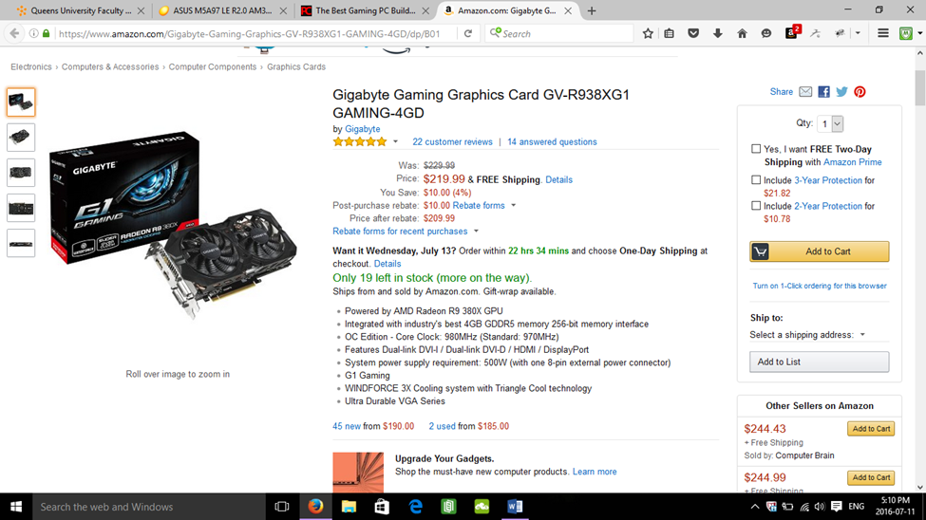
Example Continued
Graphics Card

Slide 10
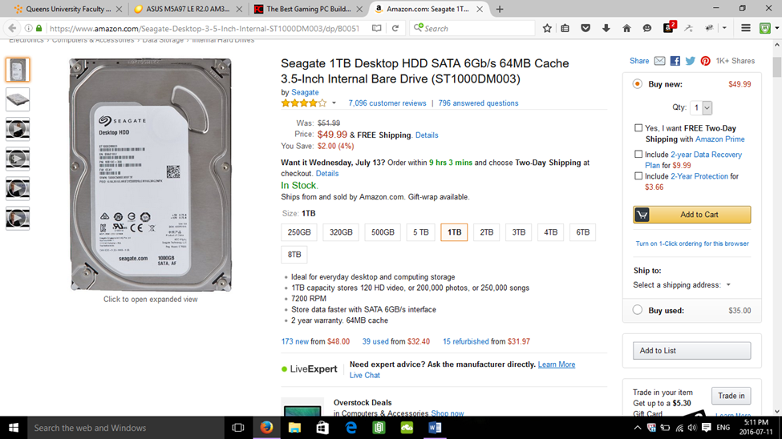
Example Continued
Internal Hard Drive

